Slide 1

Health Hub
Health Hub to order/search for Health clubs, doctors, medical services, hospitals, health insurance
By Team 4,
Vaishnavi Manjunath A20446043
Chandu Chinta A20450371

Slide 2

Project Description & Specification
A health portal to search doctors for online consultation/appointment, find hospitals, buy health Insurance plans, join health clubs and order medicines(pharmacy).
User Type:
User:
Register, Login and establish user profile
View and Search for doctors/hospitals etc.,
Schedule/Cancel/Reschedule an appointment
Deliver/pick-up medicine
Lab test reports – email/pickup
Trending services, events
Write provider reviews

Slide 3
Project Description & Specification
Admin:
Manage providers (Add, Update, Delete providers data)
Options to add customers
Maintain customer review statistics

Slide 4

Home Page

Slide 5
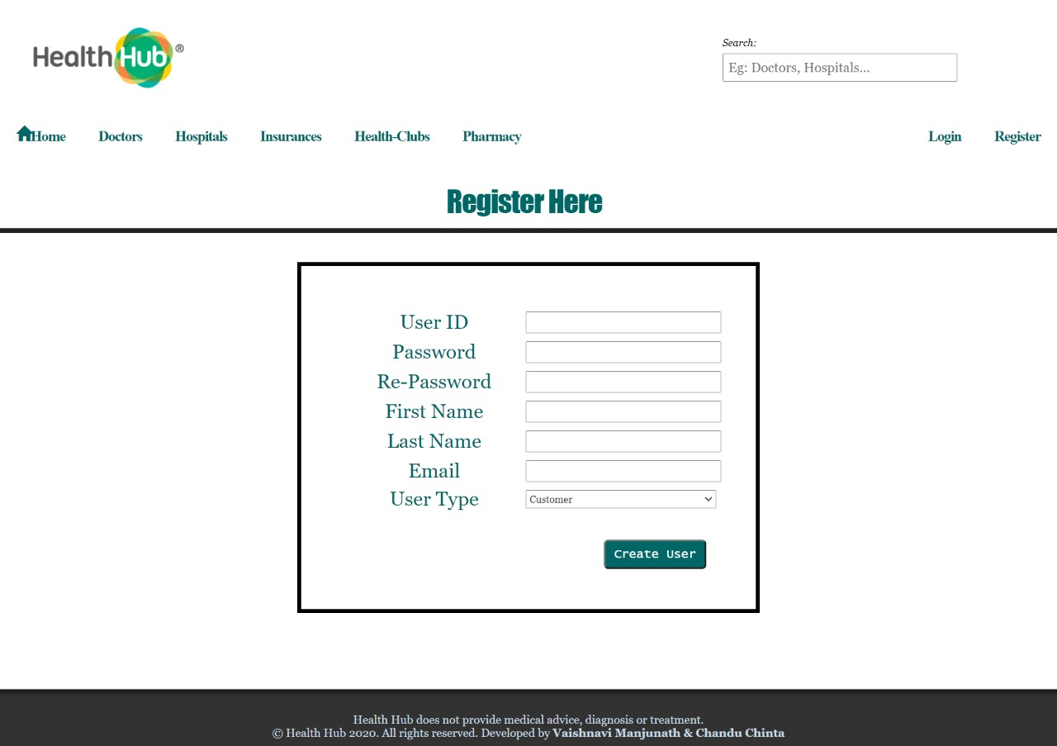
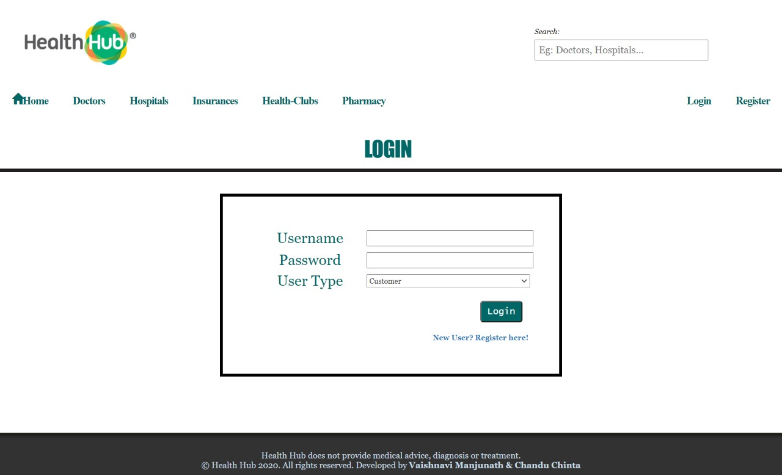
Register/Login Web Page

Slide 6
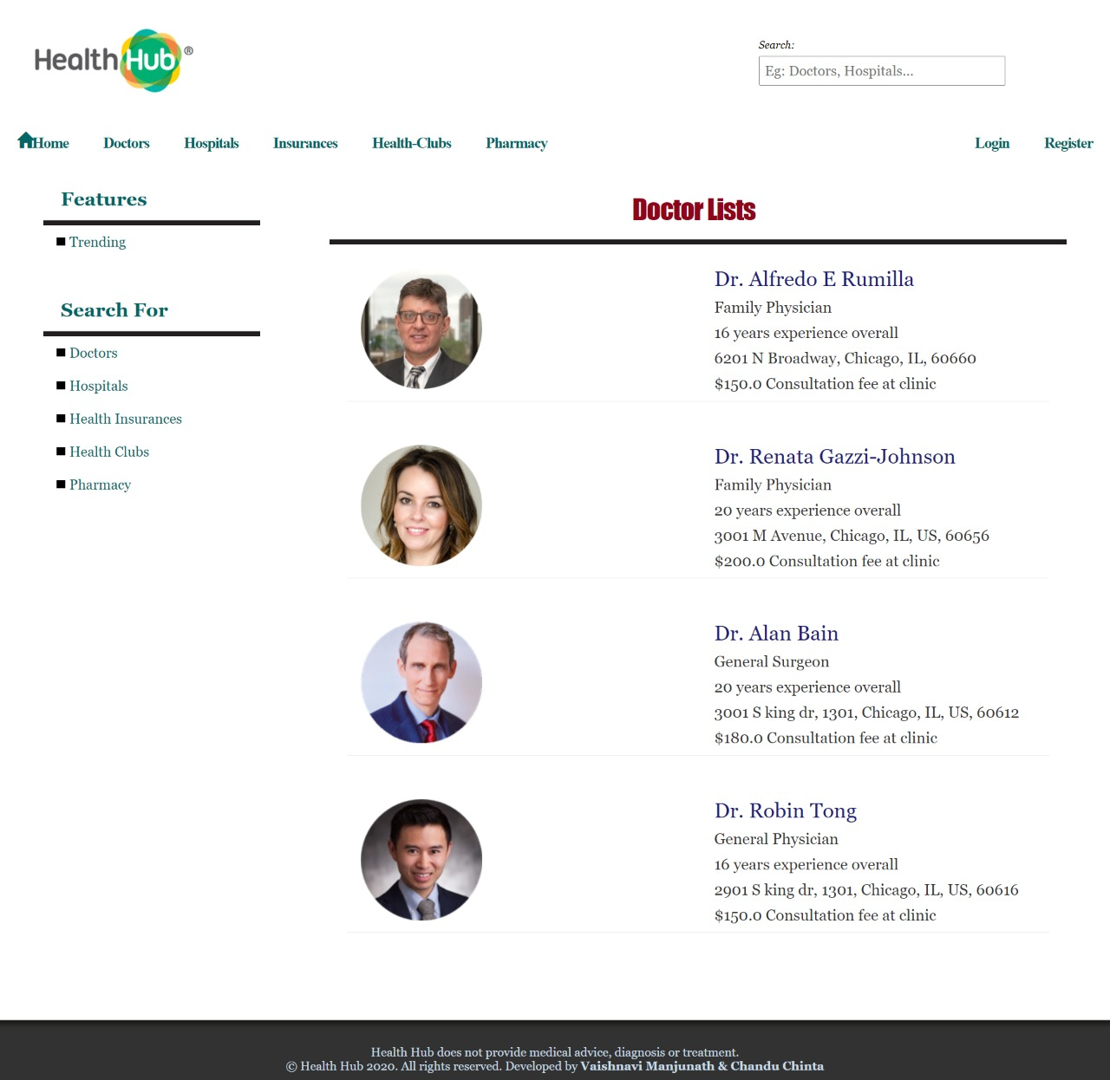
Doctors Search Web Page

Slide 7
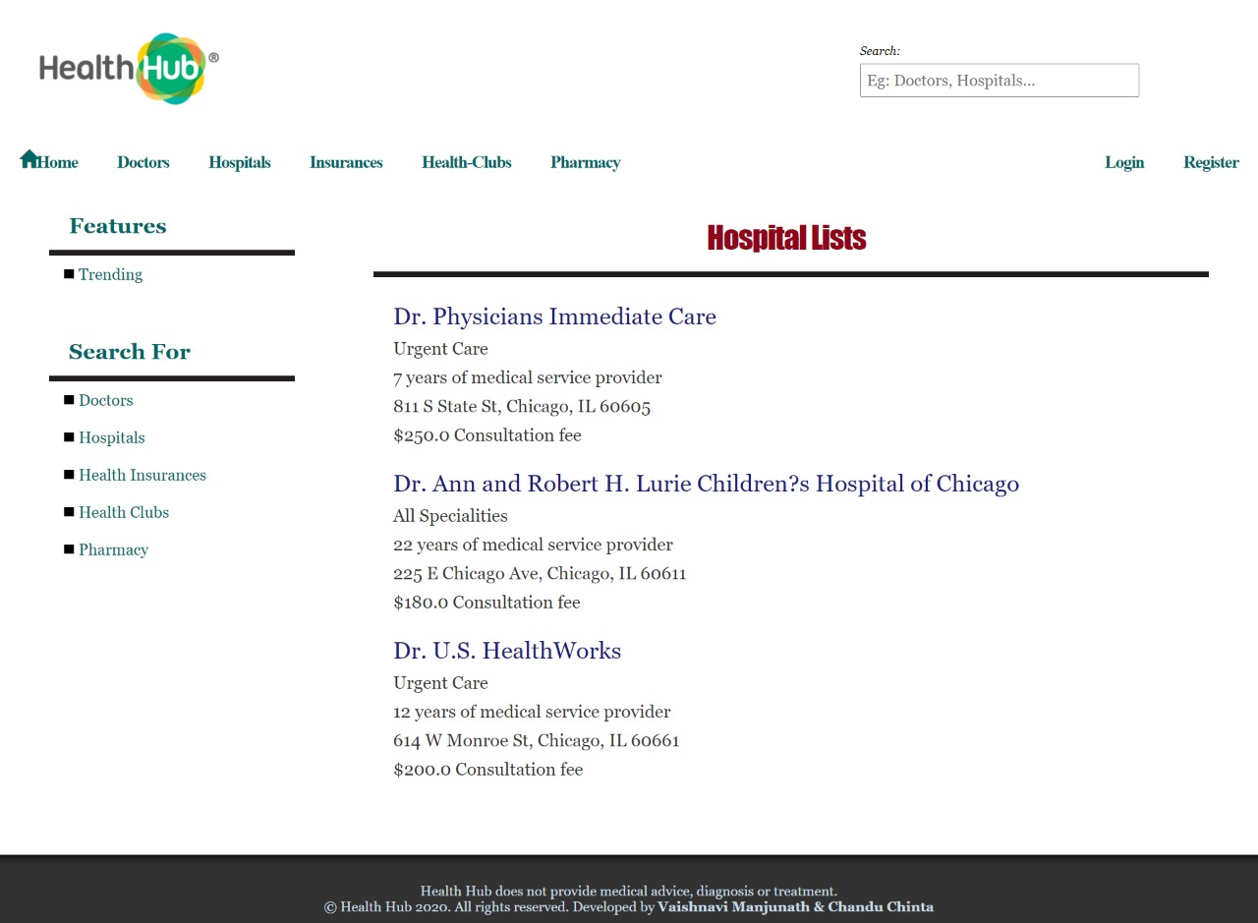
Hospitals Search Web Page

Slide 8
To Implement
Admin page
Search doctors, hospitals based on location
Managing customer reviews
Maintain profiles
Autocomplete Search
Trending Page – Showing top doctors, hospitals
Upgrade UI design

Slide 9
Thank You
Questions?
Stay safe!

